Slide 1

Neural Networks and Deep Learning

Slide 2
Table of Contents
01- Definition of ML.
02- ML use cases and examples.
03- Definition of DL.
04- Architecture of NN.
05- Perceptron.
06- Sigmoid neurons.
07- Activation functions.
08- Losss / cost function.
09- Gradient descent.
10- Backpropagation.
11- Cross entropy function.
12- Vanishing gradients.
13- Softmax function.
14- ReLU function.
15- NN design.
16- Regularization.
17- Dropout.
18- Dense layers.
19- Data processing.
20- Frameworks.
21- Keras.
22- Convolution layers.
23- Pretrained convnets.
24- Recurrent NN.
25- LSTM.
26- Genrative Adversarial Networks.
27- Deep Autoregressive Generative Sequence Models.
28- Hardware
29- Limitations.
30- References.

Slide 3
Artificial Intelligence
Machine Learning
Deep Learning

Slide 4
Machine Learning
- Machine learning: the science and art of programming computers so they can learn from data.
- In classical programming humans input rules (a program) and data to be processed according to these rules, and the outputs are answers.
- In machine learning, humans input data and the expected answers, and the outputs are the rules.
Classical programming
Rules
Answers
Data
Machine learning
Data
Rules
Answers
Adapted from ‘Deep Learning with Python’ by Francois Chollet.

Slide 5
Machine Learning
What do you need for machine learning?
- Input data points: e.g. pictures, sound files.
- Examples of the expected output (answers): e.g. tags such as ‘dogs’, ‘cats’; human-generated transcripts of sound files.
- A way to measure whether the algorithm is doing a good job: to determine the distance between the algorithm’s output and its expected output.
This is a feedback signal to adjust the way the algorithm works.
Performance
Machine learning
Data
Rules
Answers
Adapted from ‘Deep Learning with Python’ by Francois Chollet.

Slide 6
Machine Learning
What is machine learning useful for?
- Problems for which existing solutions require a lot of hand-tuning or long lists of rules.
- Complex problems for which there is no solution using a traditional approach.
- Fluctuating environments since it can adapt to new data.
- Large amounts of data.

Slide 7
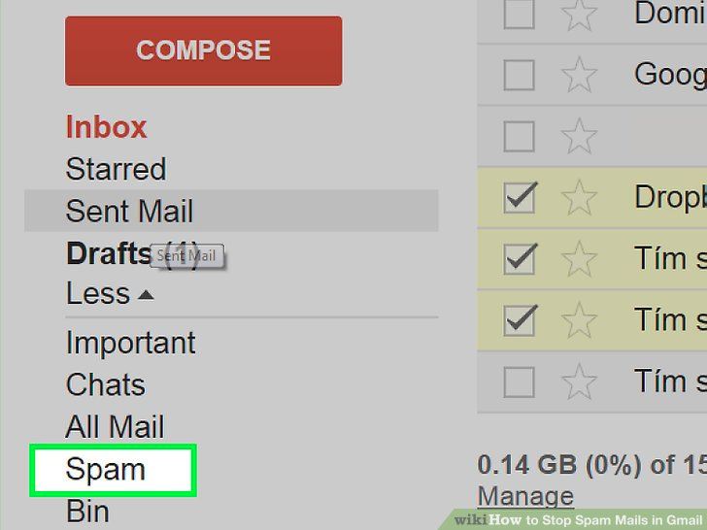

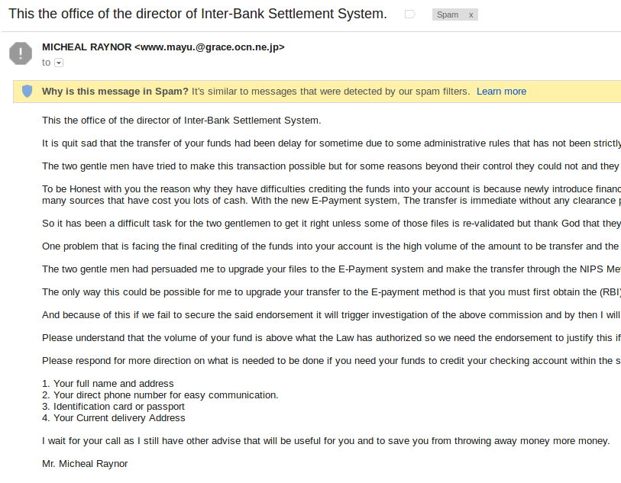
Machine Learning: Email Spam Filtering
- Machine learning algorithms deal with spam filtering problem:
e.g. multilayer perceptron, C4.5 decision tree.

Slide 8
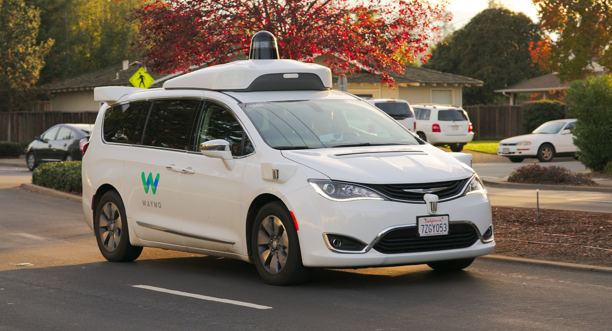

Machine Learning: Autonomous Driving
- Driver assistance: partial, conditional, high or complete automation.
By Dllu - Own work, CC BY-SA 4.0, https://commons.wikimedia.org/w/index.php?curid=64517567
By Bcschneider53 - Own work, CC BY-SA 4.0, https://commons.wikimedia.org/w/index.php?curid=63494208

Slide 9
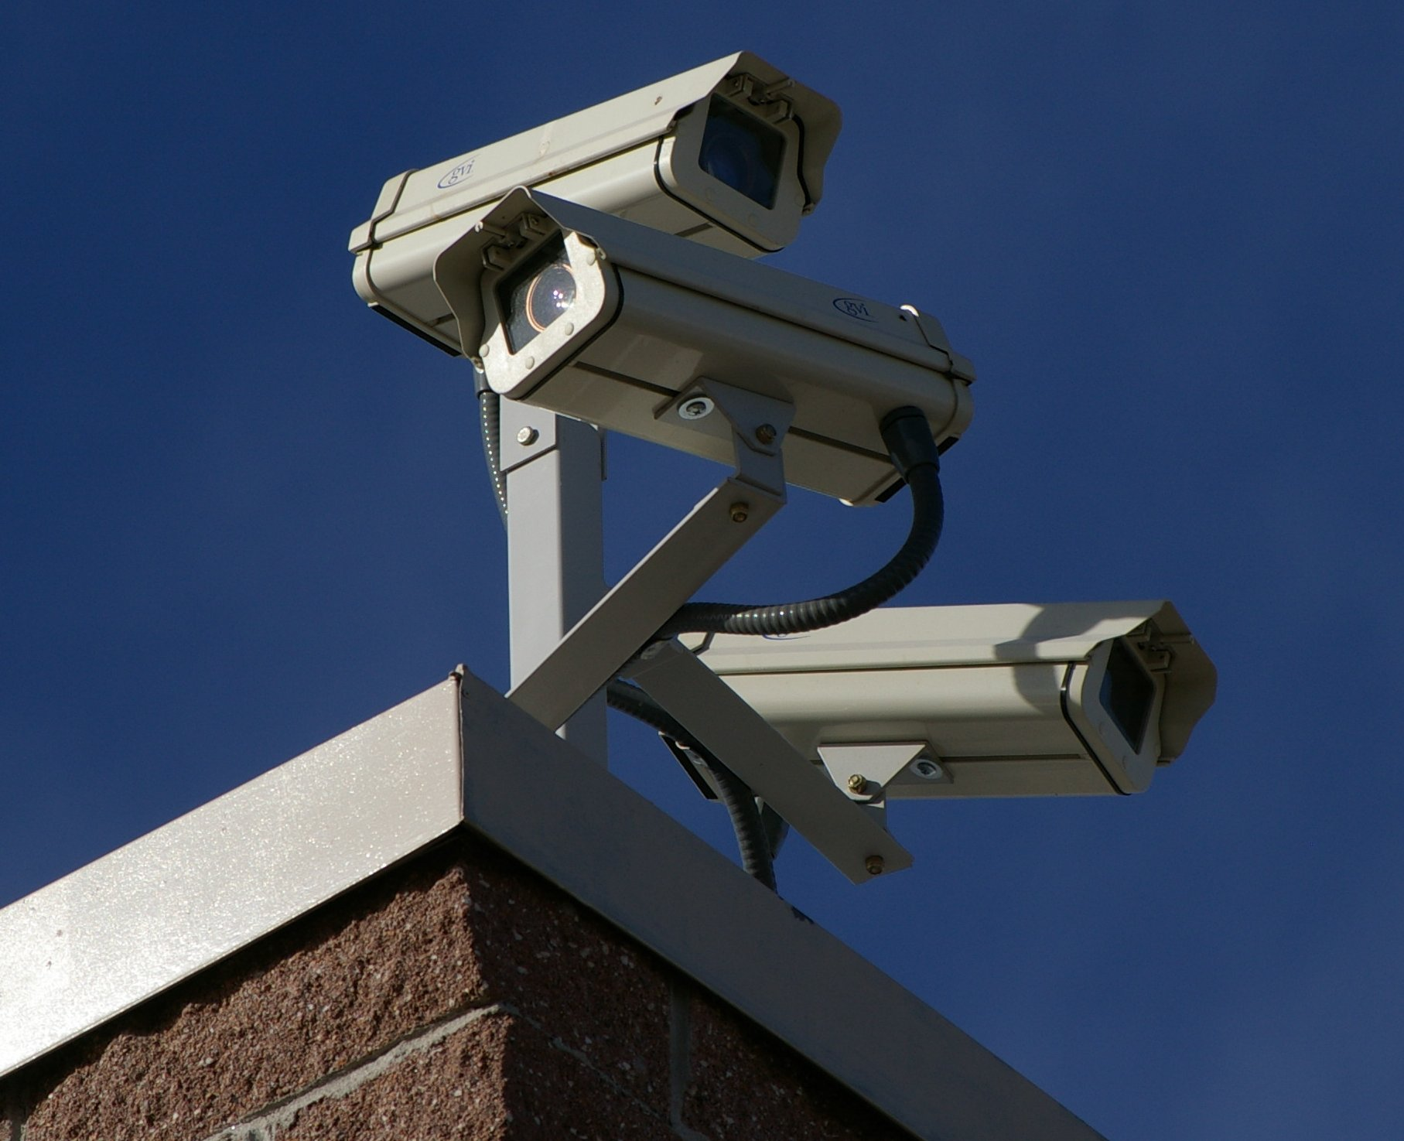
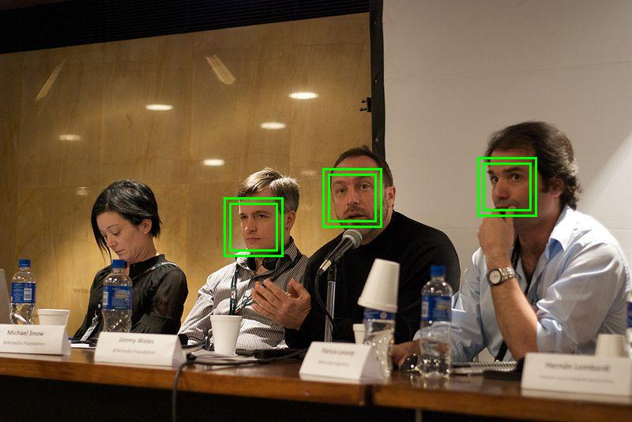
Machine Learning: Video Surveillance
- Track unusual behavior of people like stumbling or stop moving for a long time.
- Detection of intruders.
By Hustvedt - Own work, CC BY-SA 3.0, https://commons.wikimedia.org/w/index.php?curid=3466036
By Jimmy answering questions.jpg: Wikimania2009 Beatrice Murchderivative work: Sylenius (talk) - Jimmy answering questions.jpg, CC BY 3.0, https://commons.wikimedia.org/w/index.php?curid=11309460

Slide 10
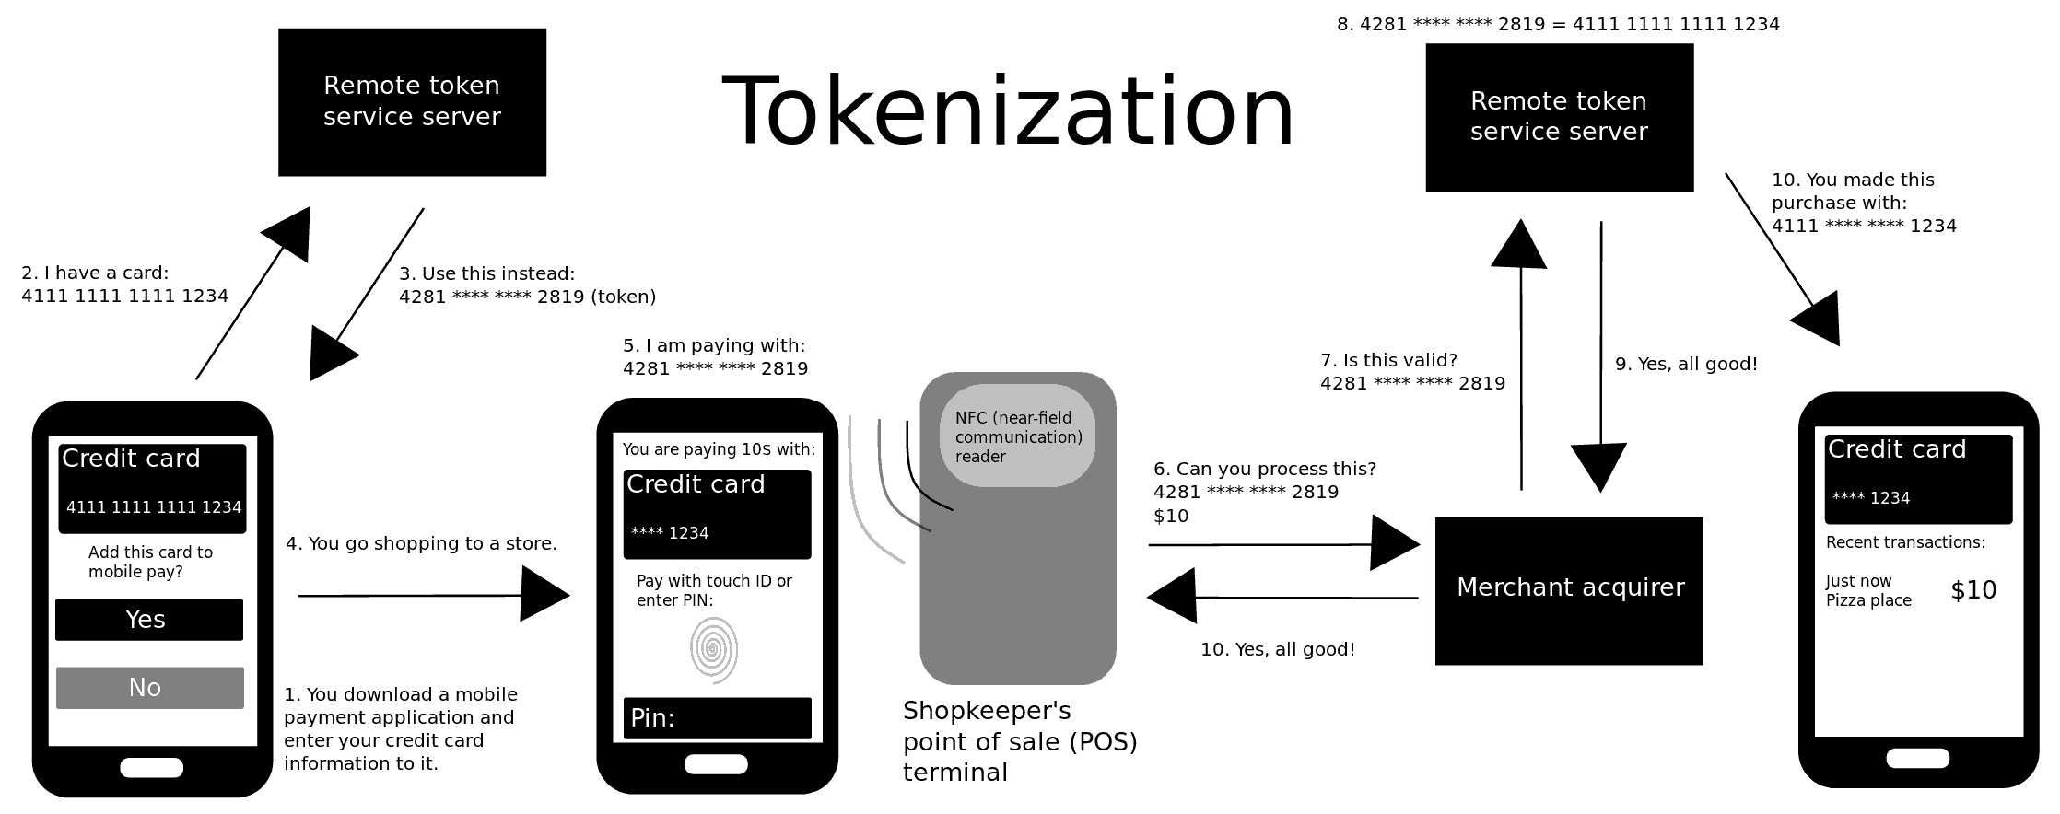
Machine Learning: Data Security
- Malwares (program or file harmful to a computer user): every new version varies between 2 and 10% from a previous one.
By Keministi - Own work, CC0, https://commons.wikimedia.org/w/index.php?curid=65840376

Slide 11
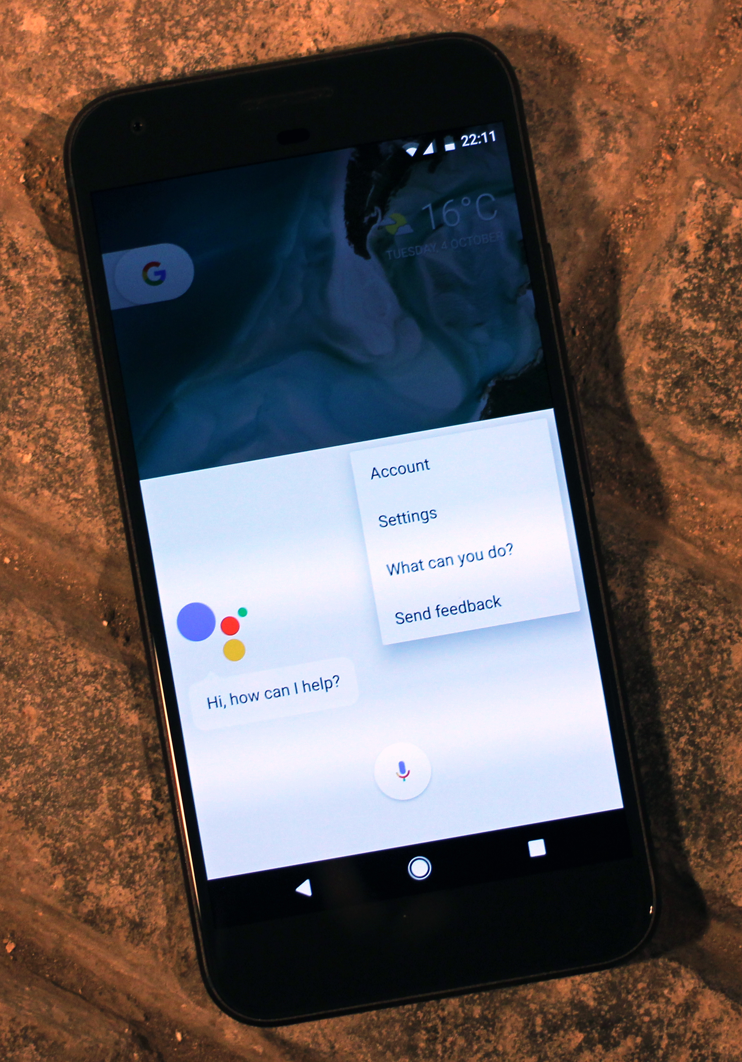
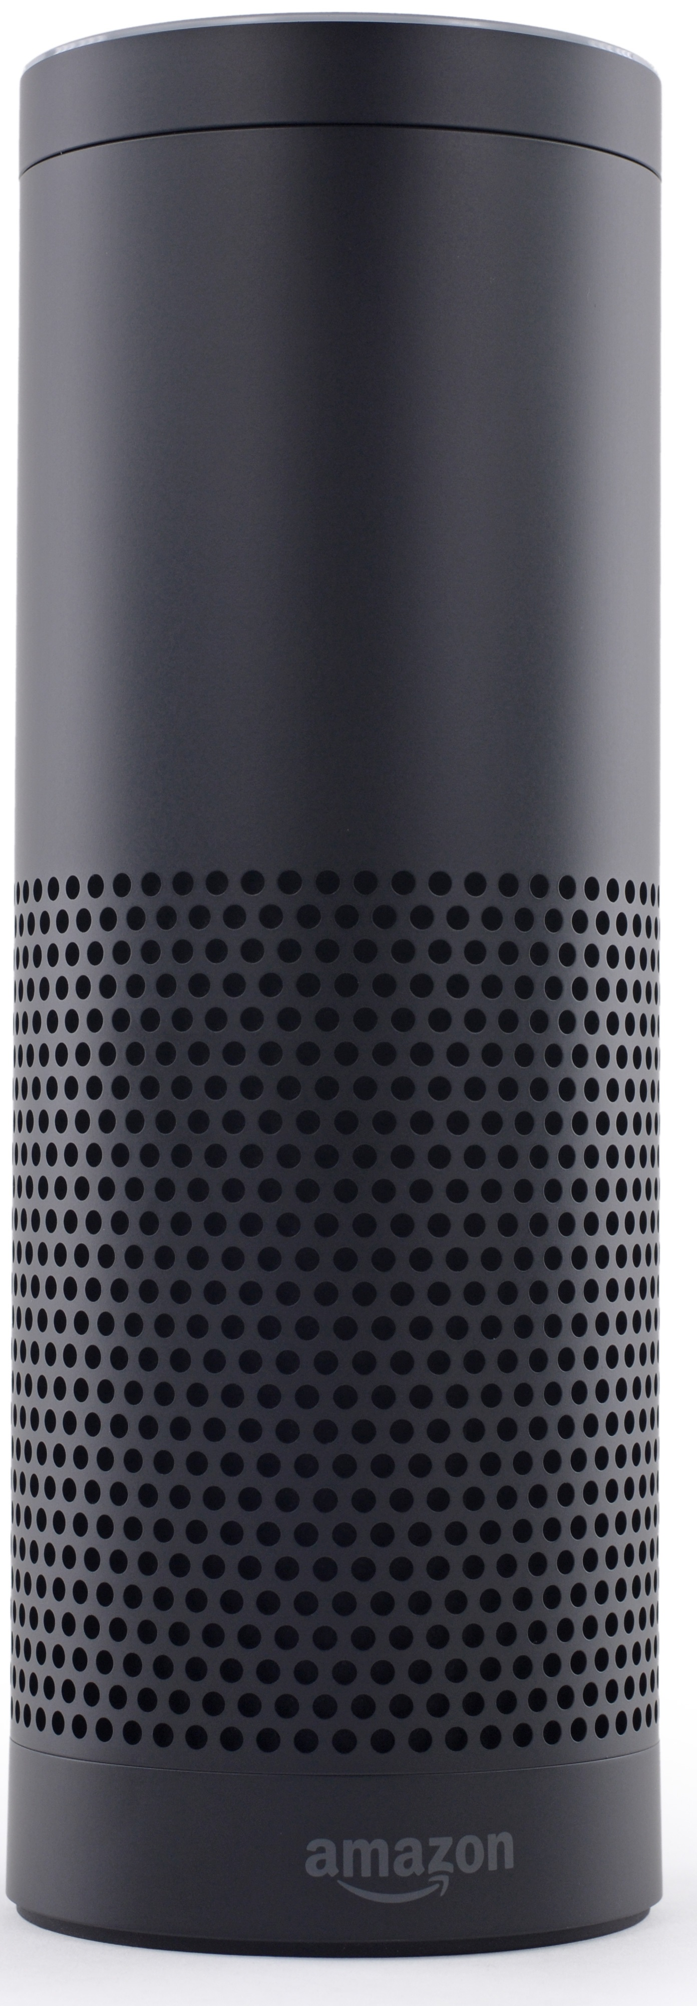
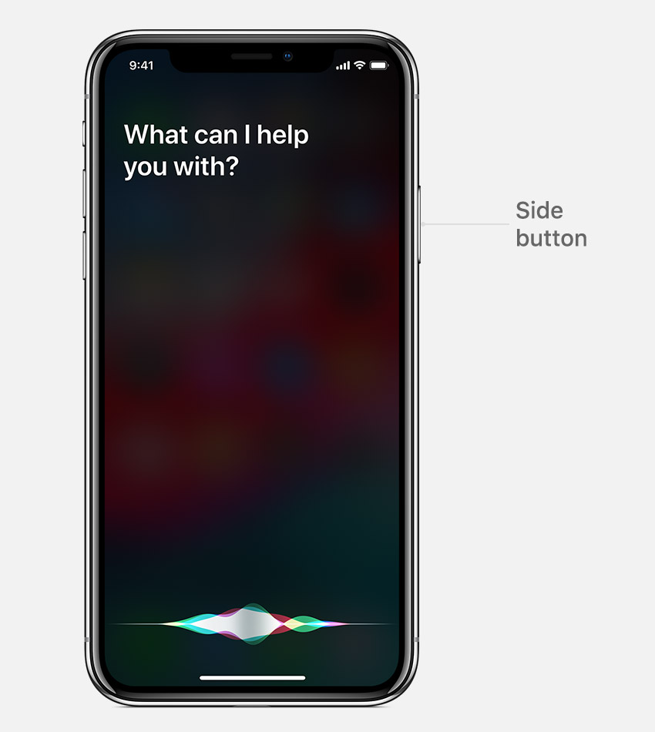
Machine Learning: Virtual Personal Assistants
- Siri, Alexa: find information when asked over voice.
By Maurizio Pesce from Milan, Italia - Android Assistant on the Google Pixel XL smartphone, CC BY 2.0, https://commons.wikimedia.org/w/index.php?curid=52110130
By Frmorrison at English Wikipedia, CC BY-SA 3.0, https://commons.wikimedia.org/w/index.php?curid=47040540
https://support.apple.com/lv-lv/HT204389

Slide 12

Machine Learning: Financial Trading
- Predict stock markets moves to improve profits.
By Katrina.Tuliao - https://www.tradergroup.org, Public Domain, https://commons.wikimedia.org/w/index.php?curid=12262407

Slide 13
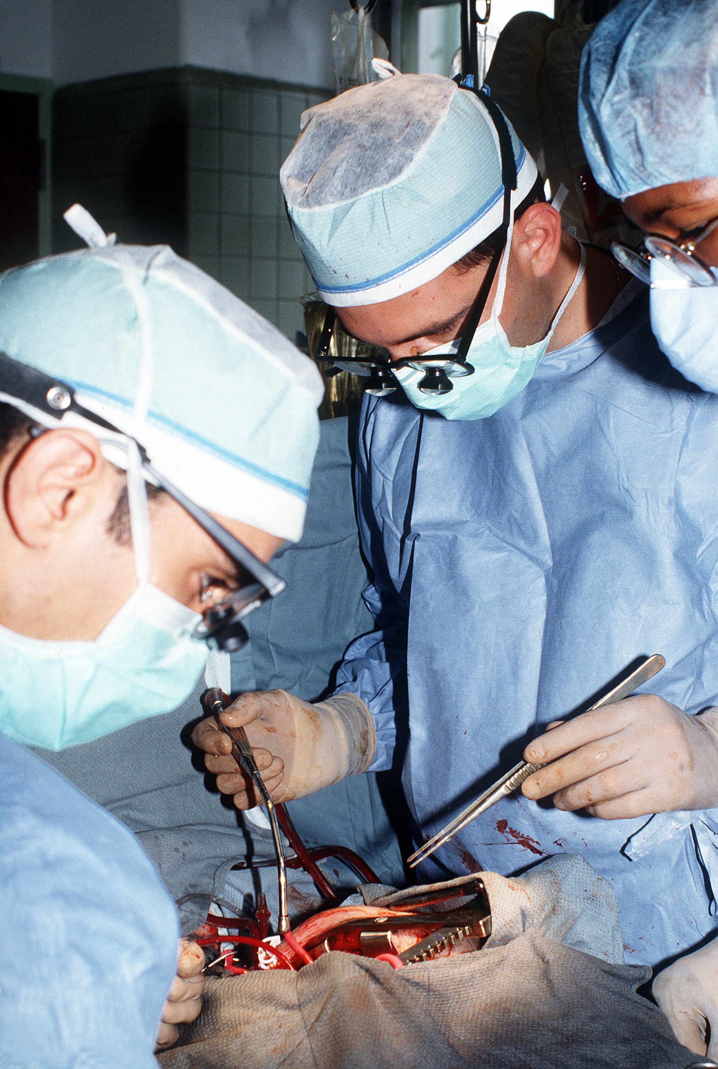

Machine Learning: Healthcare
- Disease detection, assessing risk factors, drug discovery, predict readmissions.
By Unknown - http://www.dodmedia.osd.mil/Assets/1991/Army/DA-ST-91-01841.JPEG, Public Domain, https://commons.wikimedia.org/w/index.php?curid=780720
By Seattle Municipal Archives from Seattle, WA - Doctors with patient, 1999, CC BY 2.0, https://commons.wikimedia.org/w/index.php?curid=9842204

Slide 14
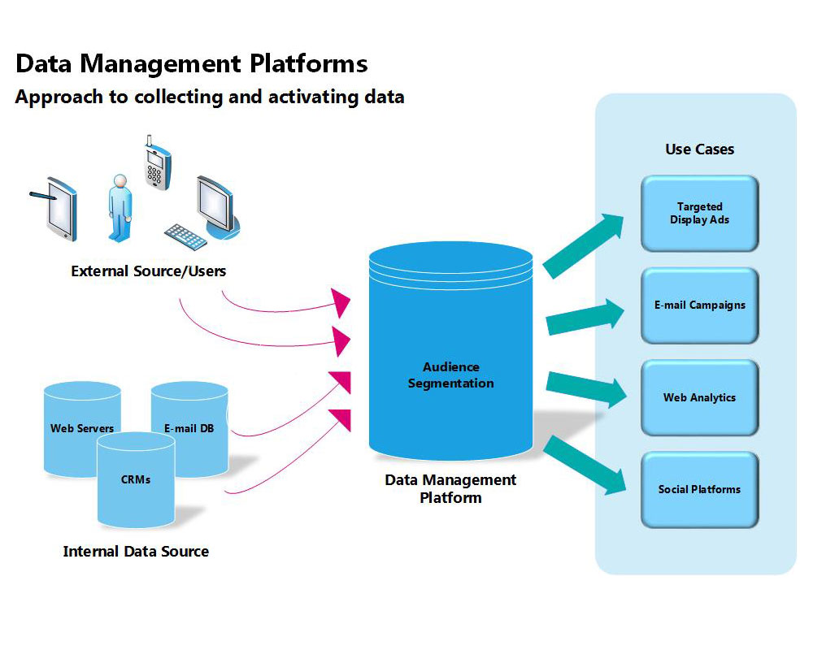
Machine Learning: Personalized Marketing
- Understand customer’s behavior to deliver individualized messages and product offerings to current or prospective customers.
By Econ5470team3 - Own work, CC BY-SA 4.0, https://commons.wikimedia.org/w/index.php?curid=48541946

Slide 15
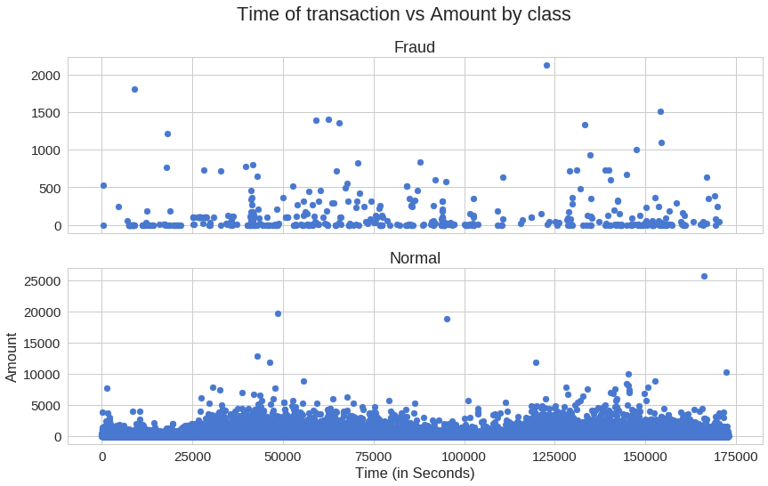
Machine Learning: Fraud Detection
- Detect potential fraud cases e.g. insurance companies, banks.
https://medium.com/@curiousily/credit-card-fraud-detection-using-autoencoders-in-keras-tensorflow-for-hackers-part-vii-20e0c85301bd

Slide 16
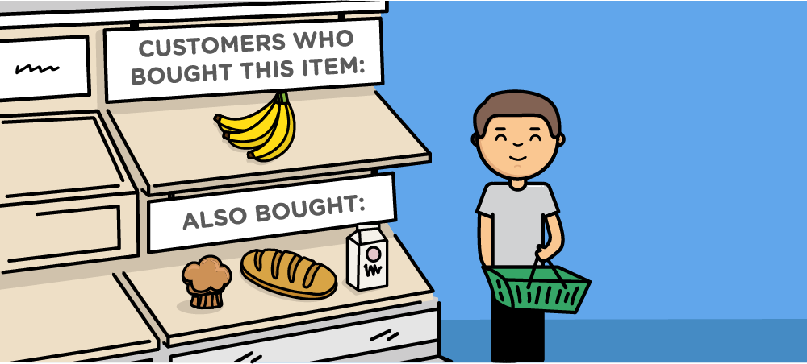
Machine Learning: Recommender Systems
- Predict the rating or preference a user would give to an item:
e.g. movie, song, research article, search queries, restaurants.
https://www.offerzen.com/blog/how-to-build-a-content-based-recommender-system-for-your-product

Slide 17
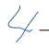
Deep Learning
Deep learning is a subfield of machine learning: learning successive layers of meaningful representations of the data.
Depth: number of layers contributing to the model of the data.
These layered representations are (almost always) learned via models called neural networks.
Neural networks: structured in layers stacked on top of each other.
Layer 1
Layer 2
Layer 3
Layer 4
Original input
0
1
2
3
4
5
6
7
8
9
Final output
Adapted from ‘Deep Learning with Python’ by Francois Chollet.

Slide 18
Deep Learning
Example: the neural network uses the examples to automatically infer rules for recognizing handwritten digits.
Layer 1
Layer 2
Layer 3
Layer 4
Original input
0
1
2
3
4
5
6
7
8
9
Final output
Adapted from ‘Deep Learning with Python’ by Francois Chollet.

Slide 19
Machine Learning
Deep Learning
Deep learning achieved breakthroughs in:
- image classification
- speech recognition
- handwriting transcription
- machine translation
- text to speech conversion
- digital assistants
- autonomous driving
- ad targeting
- search results on the web
- superhuman Go playing

Slide 20
Deep Learning – Architecture of Neural Networks
Neural networks: brain-inspired systems
input layer (contain input neurons)
output layers (contain input neurons)
(in most cases) hidden layers (contain hidden neurons)
Layer: data-processing module that extracts representations out of the data like ‘filters’.
Different layers may perform different kinds of transformations on their inputs.
Hidden
Input
Output

Slide 21
Deep Learning – Architecture of Neural Networks
Feedforward neural networks: the output from one layer is used as input to the next layer.
Recurrent neural networks: neurons which fire for some limited duration of time, before becoming quiescent. That firing can stimulate other neurons, which may fire a little while later, also for a limited duration.
Hidden
Input
Output

Slide 22
Deep Learning - Perceptron
Perceptron is a single layer neural network, feed forward model (non-cyclical).
1
w₀ / b
Bias
1
X₁
w₁
$\sum{w_{i}}x_{i}$
Output
X₂
w₂
-1
Inputs
X₃
w₃

Slide 23
Deep Learning - Perceptron
Perceptron is an algorithm for learning a binary classifier:
a function that maps its input x (a real-valued vector) to an output value f(x) (a single binary value):
$\begin{aligned}wherew.x=\sum_{m}^{i=1}{w_{i}}.x_{i} \\ m:numberofinputvalues \\ b:biasnotdependantoninputvalues\end{aligned}$
$f\left(x\right)=\left\{\begin{matrix}1 & ifw.x+b>0, \\ 0 & otherwise\end{matrix}\right.$
The Perceptron learning algorithm does not terminate if the learning set is not linearly separable.
Perceptrons can be used to compute logical functions: AND, OR.

Slide 24
Deep Learning - Perceptron
w and x are vectors whose components are the weights and inputs.
The threshold is the perceptron’s bias, b≡ −threshold.
The bias is a measure of how easy it is to get the perceptron to output a 1 or how easy it is to get the perceptron to fire:
- big bias: easy to output a 1
- negative bias: difficult to output a 1
inputs
weights
x₁
-2
$output=\left\{\begin{matrix}0 & ifw.x+b⩽0 \\ 1 & ifw.x+b>0\end{matrix}\right.$
-2
3
output
x₂
bias
Neural Networks and Deep learning by Michael Nielsen.

Slide 25
Deep Learning - Perceptron
inputs
x₁
weights
x₁ = 0; x₂= 0; w₁ = w₂ = -2; b = 3
(-2)*0 + (-2)*0 + 3 = 3 output is positive: output 1
x₁ = 0; x₂= 1 or x₁ = 1; x₂= 0; w₁ = w₂ = -2; b = 3
(-2)*0 + (-2)*1 + 3 = 1 output is positive: output 1
x₁ = 1; x₂= 1; w₁ = w₂ = -2; b = 3
(-2)*1 + (-2)*1 + 3 = -1 output is negative: output 0
-2
-2
3
output
x₂
bias
$f\left(x\right)=\left\{\begin{matrix}1 & ifw.x+b>0, \\ 0 & otherwise\end{matrix}\right.$
$\begin{aligned}wherew.x=\sum_{m}^{i=1}{w_{i}}.x_{i} \\ m:numberofinputvalues \\ b:biasnotdependantoninputvalues\end{aligned}$
Neural Networks and Deep learning by Michael Nielsen.

Slide 26
Deep Learning – Perceptron
Hidden
Hidden
Input
Output
In a network of perceptrons a small change in the weights or bias of any single perceptron in the network can cause the output of that perceptron to completely flip from 0 to 1.
That flip may then cause the behavior of the rest of the network to completely change.
Neural Networks and Deep learning by Michael Nielsen.

Slide 27
Deep Learning - Perceptron
1
w₀
Bias
1
X₁
w₁
$\sum{w_{i}}x_{i}$
Out
X₂
w₂
Activation function
-1
Inputs
X₃
w₃
Activation functions are used to map the input between the required values like (-1, 1).

Slide 28
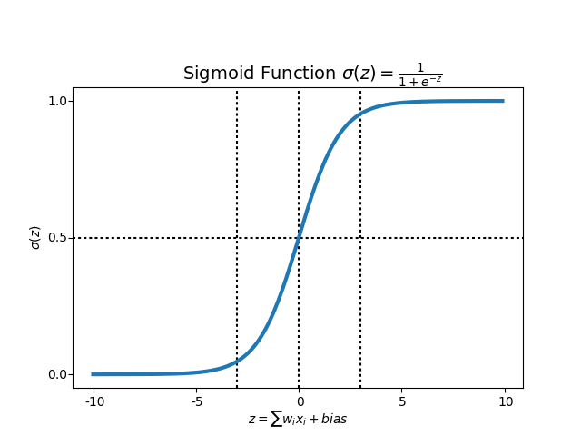
Deep Learning – Sigmoid Neurons
In sigmoid neurons small changes in their weights and bias cause only a small change in their output.
The inputs can take any value from 0 to 1.
$\begin{aligned}Δoutput≃\sum_{j}{\frac{∂output}{∂w_{j}}}Δw_{j}+\frac{∂output}{∂b}Δb \\ σ\left(wx+b\right):sigmoidfunction\end{aligned}$
Neural Networks and Deep learning by Michael Nielsen.
https://towardsdatascience.com/multi-layer-neural-networks-with-sigmoid-function-deep-learning-for-rookies-2-bf464f09eb7f

Slide 29
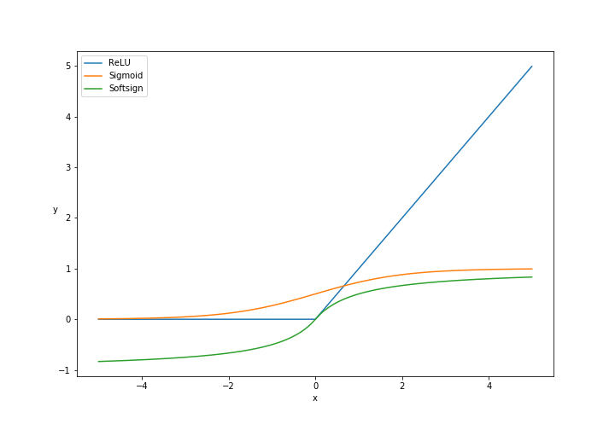

Deep Learning – Activation Functions
Scale output to acceptable range before passing it to the next layer.
Logistic (Sigmoid)
$f\left(x\right)=\frac{1}{1+e^{−x}}$
Softsign
$f\left(x\right)=\frac{x}{1+\left|x\right|}$
ReLU (rectified linear unit)
$f\left(x\right)=\left\{\begin{matrix}0 & forx<0, \\ x & forx⩾0\end{matrix}\right.$
output = relu(dot(w, x) + b) dot: dot product

Slide 30
Deep Learning - Neural Networks
The layer’s weights specify what a layer does to the input.
Initially weights are assigned random values.
Learning: finding a set of values for weights of all layers so the network maps inputs to the targets.
Adapted from ‘Deep Learning with Python’ by Francois Chollet.

Slide 31
01_Perceptron notebook

Slide 32
Deep Learning - Neural Networks
The loss function of the network takes the predictions of the network and the true target and computes a distance score.
The way the network measures its performance.
Loss is the quantity you attempt to minimize during training.
$\begin{aligned}J\left(θ\right)=\frac{1}{n}\sum_{i=1}^{n}{L}\left(y^{\left(i\right)},f\left(x^{\left(i\right)},θ\right)\right) \\ whereθ\text{is}aparameter\text{to}belearned, \\ f\left(.\right)representsthe\text{activation}\text{function}\text{and}x^{\left(i\right)}thetrainingsample\end{aligned}$
Adapted from ‘Deep Learning with Python’ by Francois Chollet.

Slide 33
Deep Learning - Neural Networks
x is a training input e.g. x is a 28 × 28 = 784-dimensional vector.
a is the vector of outputs when x is the input.
The aim of the algorithm is to minimize L (loss) or C (cost) or MSE as a function of weights and biases: find weights and biases which make the function as small as possible.
Loss/ Cost
$L\left(w,b\right)=\frac{1}{2n}\sum_{x}{{\left\|y\left(x\right)−a\right\|}^{2}}$
$a=σ\left(\sum_{x}{wx}+b\right)$
Parameter (weight) value
Neural Networks and Deep learning by Michael Nielsen.

Slide 34
Deep Learning – Gradient Descent
C (or L) as a function of 2 variables v₁ and v₂.
Move a small amount Δv₁ in the v₁ direction and a small amount Δv₂ in the v₂ direction.
$ΔC≈\frac{∂C}{∂v_{1}}Δv_{1}+\frac{∂C}{∂v_{2}}Δv_{2}$
$Δv≡{\left({Δv}_{1},{Δv}_{2}\right)}^{T}$
The gradient of C is the vector of partial derivatives:
$∇C≡{\left(\frac{∂C}{∂v_{1}},\frac{∂C}{∂v_{2}}\right)}^{T}$
Relate changes in v to changes in C:
$ΔC≈∇C.Δv$
Choose Δv so as to make ΔC negative:
$Δv=−η∇Cwhereη\text{is}asmall,positiveparametercalledlearningrate$
$\begin{aligned}ΔC≈∇C.\left(−η∇C\right)=−η{\left\|∇C\right\|}^{2} \\ where{\left\|∇C\right\|}^{2}⩾0\end{aligned}$
To make gradient descent work correctly, choose the learning rate η to be small enough not to get ∆C > 0 and not too small to make gradient descent algorithm work very slowly.
Gradient descent update rule:
$\begin{aligned}w_{k}→w´_{k}=w_{k}−η\frac{∂C}{∂w_{k}} \\ b_{l}→b´_{l}=b_{l}−η\frac{∂C}{∂b_{l}}\end{aligned}$
$v→v´=v−η∇C$
Neural Networks and Deep learning by Michael Nielsen.

Slide 35
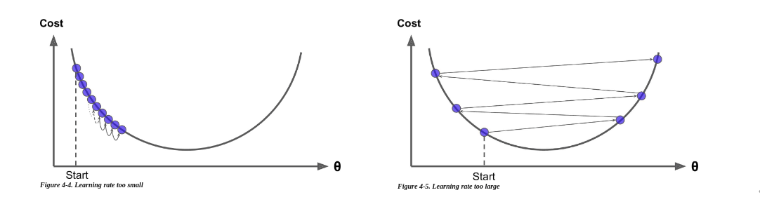
Deep Learning – Gradient Descent
Learning Rate
Adapted from ‘hands on Machine Learning with Scikit-learn and tensorFlow’ by Aurélien Géron.

Slide 36
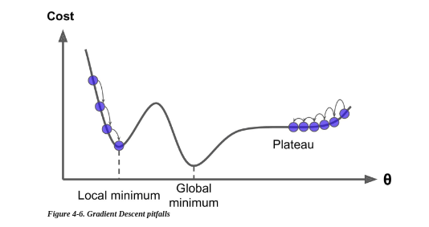
Deep Learning – Gradient Descent
Adapted from ‘hands on Machine Learning with Scikit-learn and tensorFlow’ by Aurélien Géron.

Slide 37
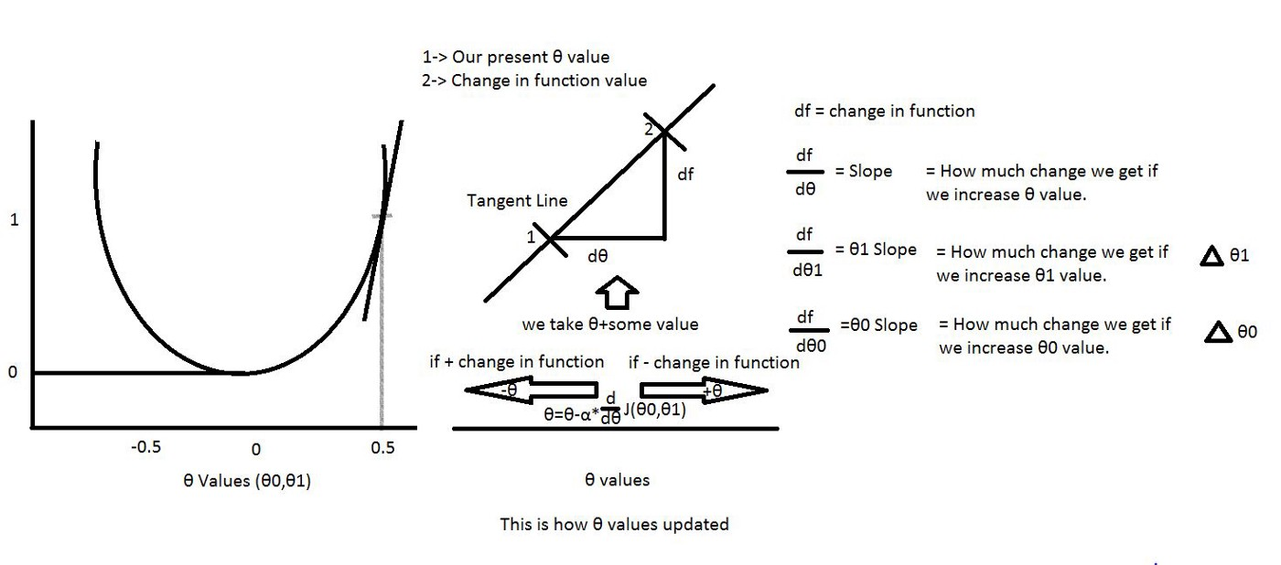
Deep Learning – Gradient Descent
1- Draw the line (tangent) from the point.
2- Find the slope of that line.
3- Identify how much change is required by taking the partial derivative of the function with respective to θ.
4- Multiply the change value with a variable called alpha (learning rate).
5- Subtract this change value from the earlier θ value to get new θ value.
$\begin{aligned}∂derivativewithrespective\text{to}θ^{0}\text{and}θ^{1}: \\ \frac{d}{dθ^{0}}J\left(θ^{0},θ^{1}\right)=\frac{1}{m}\sum_{i=1}^{m}{\left(h_{θ}\left(x^{\left(i\right)}\right)−y^{\left(i\right)}\right)} \\ \frac{d}{dθ^{1}}J\left(θ^{0},θ^{1}\right)=\frac{1}{m}\sum_{i=1}^{m}{\left(h_{θ}\left(x^{\left(i\right)}\right)−y^{\left(i\right)}\right)}.x^{\left(i\right)}\end{aligned}$
https://medium.com/deep-math-machine-learning-ai/chapter-1-2-gradient-descent-with-math-d4f2871af402

Slide 38
Deep Learning – Stochastic Gradient Descent
To compute the gradient ∇C we need to compute the gradients ∇C_{x} separately for each training input, x, and then average them.
If the the number of training inputs is very large this takes a long time.
Stochastic gradient descent: estimate the gradient ∇C by computing ∇C_{x} for a random instance in the training set.
Mini-batch gradient descent: estimate the gradient ∇C by computing ∇C_{x} for a small random set of instances called mini-batches.
Neural Networks and Deep learning by Michael Nielsen.

Slide 39
Deep Learning – Backpropagation
w ^{l}_{jk} denotes the weight for the connection from the k-th neuron in the (l − 1)-th layer to the j-th neuron in the l-th layer.
b ^{l}_{j} for the bias of the j-th neuron in the l-th layer.
a ^{l}_{j} for the activation of the j-th neuron in the l-th layer.
$a_{j}^{l}=σ\left(\sum_{k}{w_{jk}^{l}}a_{k}^{l−1}+b_{j}^{l}\right)$
$a^{l}=σ\left(w^{l}a^{l−1}+b^{l}\right)$
Hidden
layer l - 1
Hidden
layer l
Apply the weight matrix to the activations, then add the bias vector, and finally apply the σ function.
To compute a ^{l} , we compute the intermediate quantity
z ^{l} ≡ w ^{l} a ^{l-1} + b ^{l} (the weighted input to the neurons in layer l).
w ^{l}_{jk}
b ^{l}_{j}
Neurons k
Neuron j
Neural Networks and Deep learning by Michael Nielsen.

Slide 40
Deep Learning – Backpropagation
Assumptions to use backpropagation
1- The cost / loss function can be written as an average over cost functions for individual training examples x.
2- The cost function can be written as a function of the outputs from the neural network.
Backpropagation is about understanding how changing the weights and biases in a network
changes the cost / lost function: computing the partial derivatives ∂C/∂w^{l}_{jk} and ∂C/∂b^{l}_{j}.
Neural Networks and Deep learning by Michael Nielsen.

Slide 41
Deep Learning – Gradient Descent
Find the combination of weight values that gives the smallest possible loss.
Optimization algorithm to find minima of functions.
Training samples X and targets y.
Run neural network on X to obtain y_predicted.
Compute the loss, measure mismatch between y and y_predicted.
Compute the gradient of the loss with regard to the network’s parameters (backward pass).
Move the parameters in the opposite direction from the gradient reducing the loss.
Backpropagation: starts with final loss value and works backward from top to bottom layers, applying derivatives to compute each parameters contribution to the loss.
Loss/ Cost
Step, learning rate
Starting point (t=0)
t=1
t=2
t=3
Parameter (weight) value
Adapted from ‘Deep Learning with Python’ by Francois Chollet.

Slide 42
Deep Learning – Backpropagation
It adds a change Δz^{l}_{j} to the neuron’s weighted input so the neuron outputs σ(z^{l}_{j} + Δz^{l}_{j} ).
This change propagates through the layers and causing the overall cost to change in the amount:
$\frac{∂C}{∂z_{j}^{l}}Δz_{j}^{l}$
The error is defined by:
$δ_{j}^{l}≡\frac{∂C}{∂z_{j}^{l}}$
The equation for the error output layer:
$δ_{j}^{L}≡\frac{∂C}{∂a_{j}^{L}}σ´\left(z_{j}^{L}\right)$
∂C/∂a^{L}_{j} measures how fast the cost is changing as a function of the j-th output activation.
σ´(z^{L}_{j}) measures how fast the activation function σ is changing at z^{L}_{j}.
$\begin{aligned}δ^{L}=∇_{a}C⊙σ´\left(z_{j}^{L}\right) \\ where⊙is\text{the}Hadamardproductbetween2vectorsofthesamedimension \\ \text{and}∇_{a}Cisthevectorof\text{partial}derivatives\frac{∂C}{∂a_{j}^{L}}\end{aligned}$
Equation of the error in terms of the error of the next layer:
$δ^{l}=\left({\left(w^{l+1}\right)}^{T}δ^{l+1}\right)⊙σ´\left(z^{l}\right)$
Equation for the rate of change of the cost with respect to any bias in the network:
$\frac{∂C}{∂b_{j}^{l}}=δ_{j}^{l}$
Equation for the rate of change of the cost with respect to any weight in the network:
$\frac{∂C}{∂w_{jk}^{l}}=a_{k}^{l−1}δ_{j}^{l}=a_{\text{in}}δ_{out}$
Neural Networks and Deep learning by Michael Nielsen.

Slide 43
Deep Learning – Backpropagation
$\frac{∂C}{∂w_{jk}^{l}}=a_{k}^{l−1}δ_{j}^{l}=a_{\text{in}}δ_{out}$
If a_{in} ≈ 0, the gradient term ∂C/∂w will also be small.
The weight learns slowly: it’s not changing much during gradient descent.
Weights output from low-activation neurons learn slowly.
A weight in the final layer will learn slowly if the output neuron is either low activation (≈ 0)
or high activation (≈ 1): the output neuron has saturated and the weight has stopped learning (or is learning slowly).
It is similar for the biases of output neuron.
Neural Networks and Deep learning by Michael Nielsen.

Slide 44
Deep Learning – Backpropagation
Combine backpropagation with stochastic gradient descent: given a mini-batch of m training examples:
1. Input a set of training examples
2. For each training example x: Set the corresponding input activation a^{x,1} , and perform
the following steps:
• Feedforward: For each l = 2, 3, . . . , L compute z^{x,l} = w^{l} a^{x,l−1} + b^{l} and a^{x,l} = σ(z ^{x,l} ).
• Output error δ^{x,L} : Compute the vector δ^{x,L} = ∇_{a}C_{x} ⊙ σ´(z^{x,L}).
• Backpropagate the error: For each l = L − 1, L − 2, . . . , 2 compute δ^{x,l} = ((w^{l+1})^{T} δ^{x,l+1})⊙ σ´(z^{x,l}).
3. Gradient descent: For each l = L, L − 1, . . . , 2 update the weights and biases according to the rules:
$\begin{aligned}w^{l}→w^{l}−\frac{η}{m}\sum_{x}{δ^{x,l}}{\left(a^{x,l−1}\right)}^{T} \\ b^{l}→b^{l}−\frac{η}{m}\sum_{x}{δ^{x,l}}\end{aligned}$
Neural Networks and Deep learning by Michael Nielsen.

Slide 45
Deep Learning – Backpropagation
For each training instance backpropagation algorithm:
- makes a prediction (forward pass)
- measures the error
- goes through each layer in reverse to measure the error contribution from each connection (reverse pass)
- tweaks the connection weights to reduce the error (Gradient Descent step)

Slide 46
Deep Learning - Neural Networks
This score (error) is used as feedback signal to adjust the values of the weights and lower the loss score.
The optimizer (i.e. gradient descent ) is the mechanism through which the network updates its parameters (weights) based on data and its loss function.
The optimizer adjusts the weights implementing backpropagation algorithm.
Adapted from ‘Deep Learning with Python’ by Francois Chollet.

Slide 47
Deep Learning - Neural Networks
Input A
Weights
Layer
(data transformation)
Weights
Layer
(data transformation)
Optimizer
Predictions
Targets
Loss function
Score / Error
Adapted from ‘Deep Learning with Python’ by Francois Chollet.

Slide 48
Deep Learning – Cross Entropy Cost / Loss Function
$C=\frac{1}{n}\sum_{x}{\left[ylna+\left(1−y\right)ln\left(1−a\right)\right]}$
1- It’s non-negative, C > 0.
2- If the neuron’s actual output is close to the desired output for all training inputs, x, then the cross-entropy will be close to 0.
The cross-entropy cost function has the benefit that, unlike the quadratic cost, it avoids the problem of learning slowing down.
x₁
w₁
w₂
b
a = σ (z)
x₂
Neural Networks and Deep learning by Michael Nielsen.

Slide 49
Deep Learning – Cross Entropy Cost / Loss Function
Compute the partial derivative of the cross-entropy cost with respect to the weights:
$\frac{∂C}{∂w_{j}}=\frac{1}{n}\sum_{x}{\frac{σ´\left(z\right)x_{j}}{σ\left(z\right)\left(1−σ\left(z\right)\right)}}\left(σ\left(z\right)−y\right)$
Using the definition of the sigmoid function as σ(z) = 1/(1+e ^{-z}) so that σ´(z) = σ(z)(1 – σ(z)):
$\frac{∂C}{∂w_{j}}=\frac{1}{n}\sum_{x}{x_{j}}\left(σ\left(z\right)−y\right)$
The rate at which the weight learns is controlled by σ(z) − y, i.e., by the error in the output.
The larger the error, the faster the neuron will learn.
It avoids the learning slowdown caused by the σ´(z) term in the analogous equation for the quadratic cost.
Neural Networks and Deep learning by Michael Nielsen.

Slide 50
Deep Learning – Vanishing Gradients
Sigmoid – activation function
- the input is transformed into a value between 0.0 and 1.0
- only sensitive to changes around their mid-point of their input
- the derivatives are close to 0: the error decreases dramatically with each additional layer through propagation
- continued training does not result in any further improvement and weights change more close to output layers than input layers
https://towardsdatascience.com/multi-layer-neural-networks-with-sigmoid-function-deep-learning-for-rookies-2-bf464f09eb7f

Slide 51
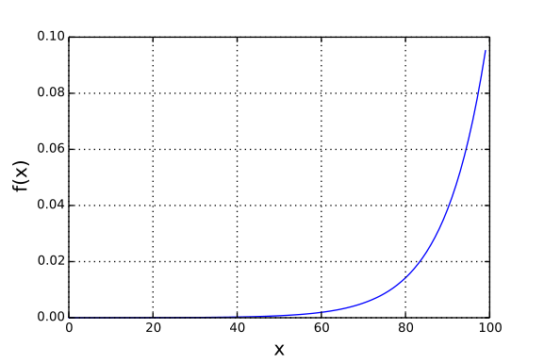
Deep Learning – Softmax
$a_{j}^{L}=\frac{e^{x_{j}^{L}}}{\sum_{k}{e^{z_{k}^{L}}}}$
A new type of output layer for neural networks:
where in the denominator we sum over all the output neurons.
The output activations always sum up to 1: it can be thought of as a probability distribution.
Neural Networks and Deep learning by Michael Nielsen.
https://adl1995.github.io/an-overview-of-activation-functions-used-in-neural-networks.html

Slide 52
Deep Learning – Softmax
In the MNIST classification problem, we can interpret a^{L}_{j} as the network’s estimated probability that the correct digit classification is j, used in cases of mutually exclusive classes (not multioutput, i.e. recognize multiple people in a picture).
If the output layer was a sigmoid layer, then we couldn’t assume that the activations formed a probability distribution.
Neural Networks and Deep learning by Michael Nielsen.

Slide 53

Deep Learning – Vanishing Gradients
ReLU – activation function
- returns 0 for any negative input and y=x for any positive value
- non-linear activation function, learns much faster in networks with many layers
- it has a derivative of 0 over half it's range (the negative numbers) and 1 for positive inputs
- when training many inputs the average derivative is rarely close to 0 avoiding vanishing gradients
- it is not differentiable at 0 but in practice, gradient descent still performs well enough
https://medium.com/@kanchansarkar/relu-not-a-differentiable-function-why-used-in-gradient-based-optimization-7fef3a4cecec

Slide 54
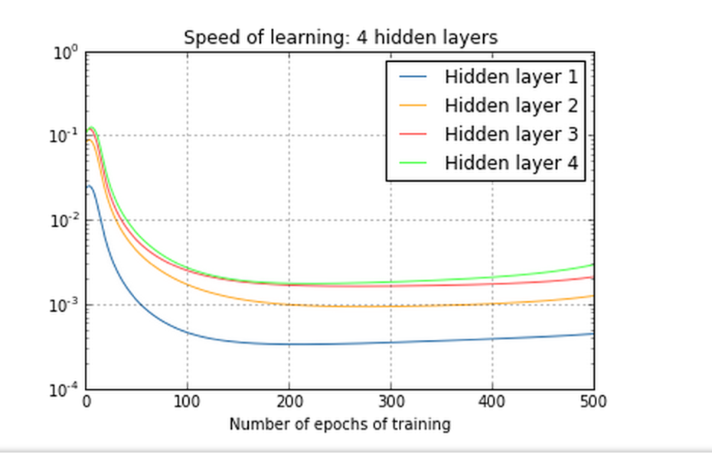
Deep Learning – Vanishing Gradients

Slide 55
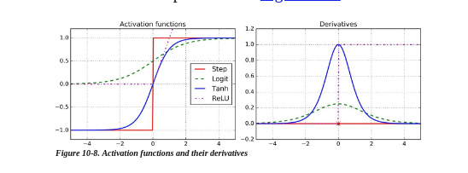
Deep Learning – Activation Functions
Adapted from ‘hands on Machine Learning with Scikit-learn and tensorFlow’ by Aurélien Géron.

Slide 56
Deep Learning - Neural Networks
Neural networks design
1- activation function
2- loss function:
- classification: crossentropy (when output is a probability)
- regression: mean squared error (MSE)
3- regularization term: L1 or L2.
Evaluation metrics
- classification: accuracy.
- regression: mean absolute error (MAE)

Slide 57
Deep Learning - Neural Networks
Overfitting the training data: the model performs well on training data but does not generalize well.
If the model is overfitting the possible solutions are to simplify the model, constrain it (e.g. regularize it), or get more training data.
Regularization
- Constraining the model to make it simpler and reduce the risk of overfitting.
- For example in a polynomial model: reduce the number of polynomial degrees.

Slide 58
Deep Learning - Neural Networks
L1 Regularization – Cross Entropy
Regularization parameter
Regularization term
$C=\frac{1}{n}\sum_{xj}{\left[y_{j}lna_{j}^{L}+\left(1−y_{j}\right)ln\left(1−a_{j}^{L}\right)\right]}+\frac{λ}{2n}\sum_{w}{\left\|w\right\|}$
$C=C_{0}+\frac{λ}{2n}\sum_{w}{\left\|w\right\|}$
weights w may be reduced to zero

Slide 59
Deep Learning - Neural Networks
L2 Regularization – Cross Entropy
Regularization parameter
Regularization term
$C=\frac{1}{n}\sum_{xj}{\left[y_{j}lna_{j}^{L}+\left(1−y_{j}\right)ln\left(1−a_{j}^{L}\right)\right]}+\frac{λ}{2n}\sum_{w}{{\left\|w\right\|}^{2}}$
$C=C_{0}+\frac{λ}{2n}\sum_{w}{{\left\|w\right\|}^{2}}$
λ small: minimize the original C₀
λ big: minimize w
weights w decay towards zero but not exactly zero

Slide 60
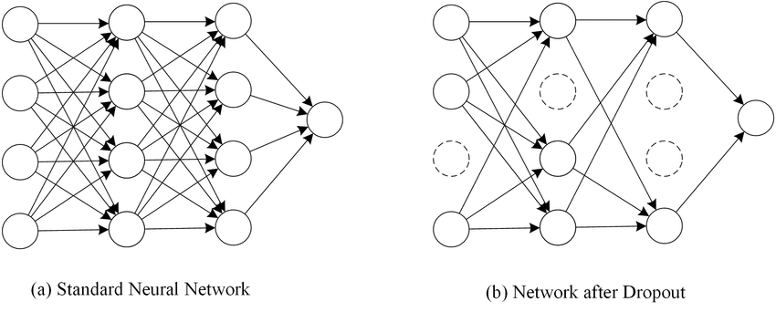
Deep Learning – Neural Networks
Dropout
- a regularization technique for neural networks
- applied to a layer, randomly drop out (set to zero) a number of output features of the layer during training
- randomly (and temporarily) deleting a fraction of the hidden neurons in the network, while
leaving the input and output neurons untouched
- dropout rate: fraction of the features that are zeroed out (between 0.2 and 0.5)
Multiple Instance Fuzzy Inference Neural Networks. AB Khalifa, H Frigui - arXiv preprint arXiv:1610.04973, 2016 - arxiv.org

Slide 61
Deep Learning – Neural Networks
Dropout
- to dropout different sets it’s like training different neural networks
- it is like averaging the effects of a very large number of different networks
- different networks will overfit in different ways so the net effect of dropout will be to reduce overfitting
Multiple Instance Fuzzy Inference Neural Networks. AB Khalifa, H Frigui - arXiv preprint arXiv:1610.04973, 2016 - arxiv.org

Slide 62
Deep Learning - Neural Networks
Set hyperparameters
- Start with the simplest network that can do meaningful learning.
- Learning rate: estimate the threshold value at which the cost on the training data immediately begins decreasing, instead of oscillating or increasing, use η at no larger that this threshold.
- Use early stopping to determine the number of epochs: compute accuracy at the end of each epoch and end when it stops improving.
- Regularization parameter: start with no regularization, and then increase it with a factor of 10 to find the order of magnitude.
- Mini-batch size: plot validation accuracy vs time and choose the size that gives a fast improvement in performance.
- Variations of stochastic gradient descent: i.e. momentum-based gradient descent.
Neural Networks and Deep learning by Michael Nielsen.

Slide 63
Deep Learning – Dense Layers
Dense → - fully connected layers
- learn global patterns in input feature space
N° of hidden units of the layer
Binary classification:
- network ends with Dense layer with one unit and sigmoid activation
Dense (16)
Input
Dense (16)
Dense (1)
Output
More hidden units (higher dimensional representation space):
- learn complex representations
- network computationally expensive i.e. 28x28 pixel images: 784 input neurons fully connected
reLU
Sigmoid
W shape (input_dimension, 16).

Slide 64
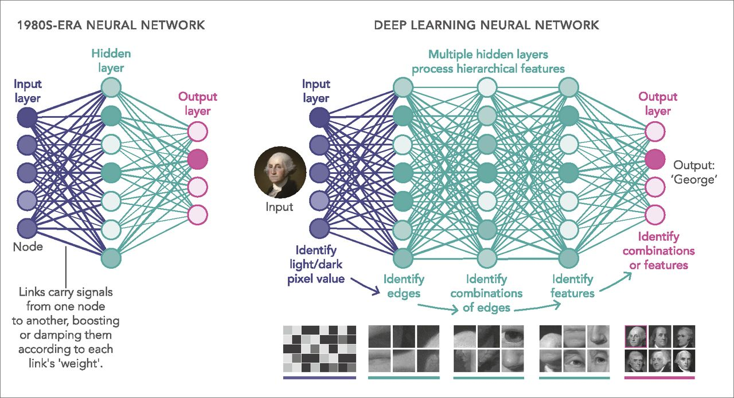
Deep Learning
https://www.pnas.org/content/116/4/1074

Slide 65
Deep Learning
Data Representations for Neural Network
Tensors ------> multidimensional Numpy arrays
- Scalars (0D tensors)
- Vectors (1D tensors)
- Matrices (2D tensors)
- 3D tensors and higher-dimensional tensors
Key attributes of a tensor:
- number of axes (rank)
- shape
- data type
Adapted from ‘Deep Learning with Python’ by Francois Chollet.

Slide 66
Deep Learning
Data Pre-processing for Neural Network
- Vectorization: inputs and targets must be tensors of floating-point data (or integers).
- Value normalization: each feature has standard deviation of 1 and mean 0.
- Handling missing values.
- Feature engineering.

Slide 67



Frameworks
TensorFlow
- open source software library for numerical computation
- first defines in Python a graph of computations to perform, takes that graph and runs it in C++
- low and high level API
- difficult to perform debugging
- good for large datasets, high performance, functionality
Keras
- open source neural network library that enables fast experimentation with deep neural networks
- written in Python
- capable of running on top of TensorFlow, CNTK and Theano
- high level API
- slower performance
- good for rapid prototyping, small datasets and multiple back-end support
Pytorch
- open source machine learning library for Python
- based on Torch
- low level API
- good for flexibility, short training duration and debugging capabilities

Slide 68
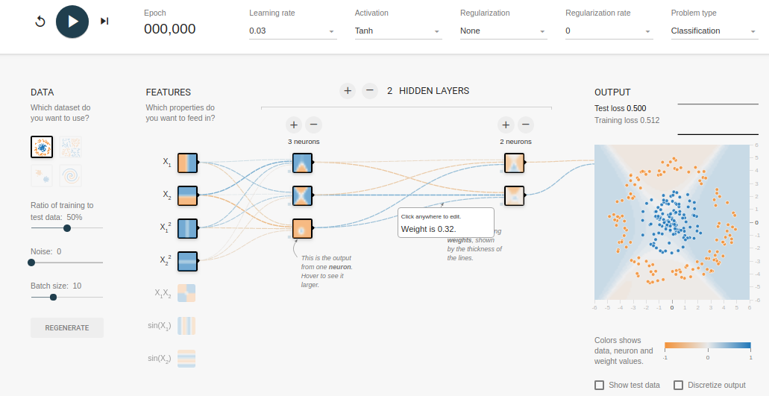
Frameworks - TensorFlow
https://playground.tensorflow.org/

Slide 69

Frameworks - Keras
https://keras.io/

Slide 70
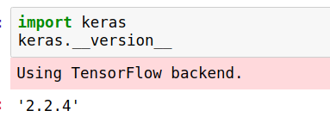
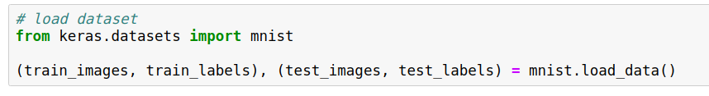
Frameworks - Keras

Slide 71
Deep Learning - Neural Networks
Neural networks design
1- activation function
2- loss function:
- classification: crossentropy (when output is a probability)
- regression: mean squared error (MSE)
3- regularization term: L1 or L2.
Evaluation metrics
- classification: accuracy.
- regression: mean absolute error (MAE)
Adapted from ‘Deep Learning with Python’ by Francois Chollet.

Slide 72
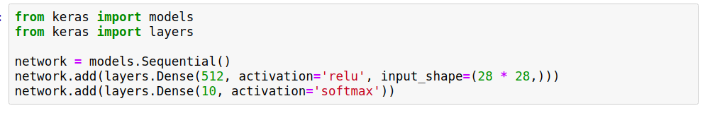
Frameworks - Keras
argument to the first layer
units
activation functions

Slide 73
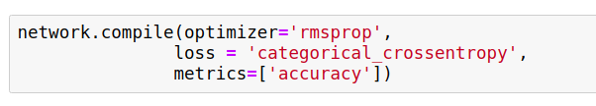
Frameworks - Keras
optimization method i.e. gradient descent
Rsmprop
- similar to gradient descent with momentum
- scales the learning rate so the algorithms goes through saddle point faster
evaluate training and testing
Accuracy (ratio of correct predictions)
TP + TN
TP + TN + FP + FN
TP: true positive TN: true negative
FP: false positive FN: false negative

Slide 74
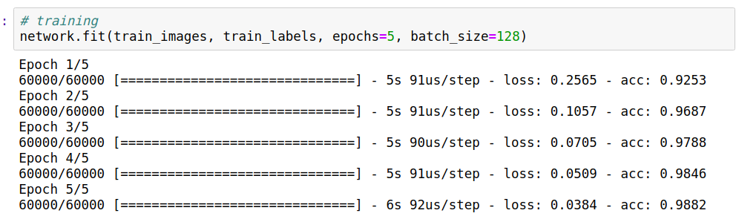
Frameworks - Keras
each iteration over all training data
the network iterates on training data in mini-batches of n samples

Slide 75
02_Introduction_to_Neural_Networks notebook
03_Binary_Classification notebook
04_Regression notebook

Slide 76

Deep Learning – Convolution Layers
Convolution
- best tool for visual-classification problems
- learn local patterns in input feature space
- patterns learned are translation invariant
- learn spatial hierarchies of patterns
- operate on 3D tensors (feature map) with 2 spatial axis (height, width) and depth axis (channels axis)
- the output is a 3D tensor
By Aphex34 - Own work, CC BY-SA 4.0, https://commons.wikimedia.org/w/index.php?curid=45679374

Slide 77
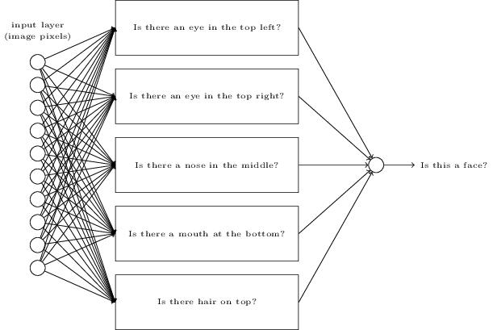
Deep Learning – Convolution Layers
Feature hierarchy
Neural Networks and Deep learning by Michael Nielsen.

Slide 78
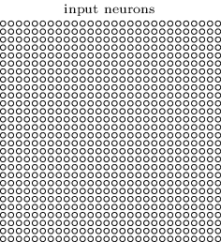
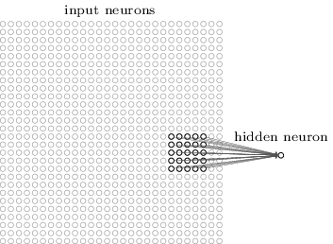
Deep Learning – Convolution Layers
Local receptive field for the hidden neuron
24x24 neurons in the hidden layer
28x28 input image
5x5 region: 25 input pixels
Feature map: map from the input layer to the hidden layer.
Neural Networks and Deep learning by Michael Nielsen.

Slide 79
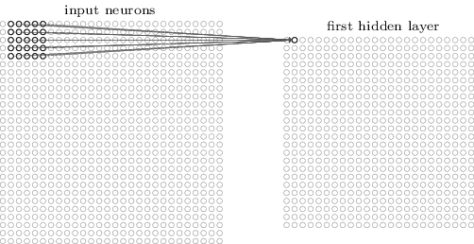
Deep Learning – Convolution Layers
Move the local receptive field 1 pixel to the right or down (stride length):
All neurons in this layer detect the same feature: only different locations in the input image
Each hidden neuron has b and 5x5 weights connected to its local receptive field
Each of the 24x24 hidden neurons share the same weights (shared weights) and bias (kernel, filter: shared weight and bias).
Neural Networks and Deep learning by Michael Nielsen.

Slide 80
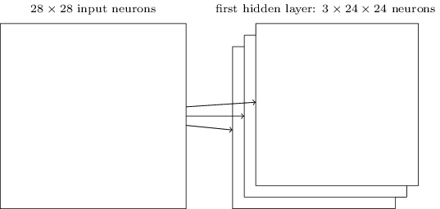
Deep Learning – Convolution Layers
A complete convolutional layer consists of several different feature maps:
3 feature maps: each has its 5x5 shared weights and biases
3 feature maps, 3 different features detected.
Each feature detectable across the entire image.
Neural Networks and Deep learning by Michael Nielsen.

Slide 81
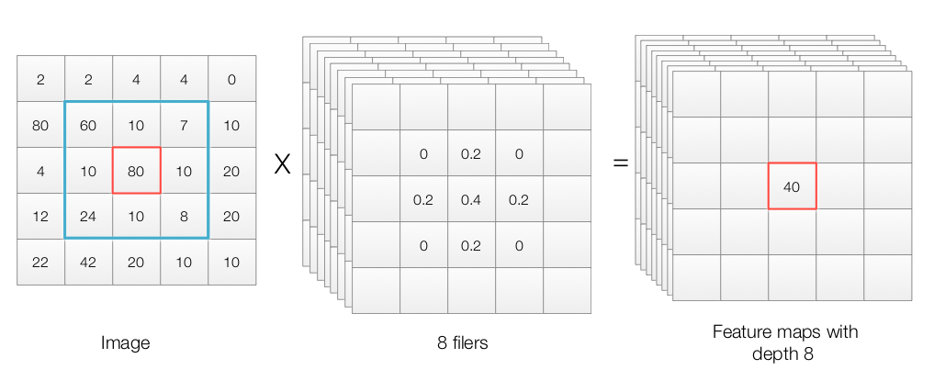
Deep Learning – Convolution Layers
Convolution – Key parameters
- size of the patches extracted from the inputs e.g 3x3
- depth of the output feature map: the number of filters computed by the convolution
image
8 filters
Feature maps with depth 8
https://jhui.github.io/2017/03/16/CNN-Convolutional-neural-network/

Slide 82
Deep Learning – Convolution Layers
Each feature map 5x5 = 25 shared weights and 1 bias = 26 parameters
$\begin{aligned}a^{1}=σ\left(b+w∗a^{0}\right) \\ wherea^{1}isthesetofoutputactivations \\ a^{0}isthesetofinputactivations \\ \text{*}convolutionoperation\end{aligned}$
Neural Networks and Deep learning by Michael Nielsen.

Slide 83
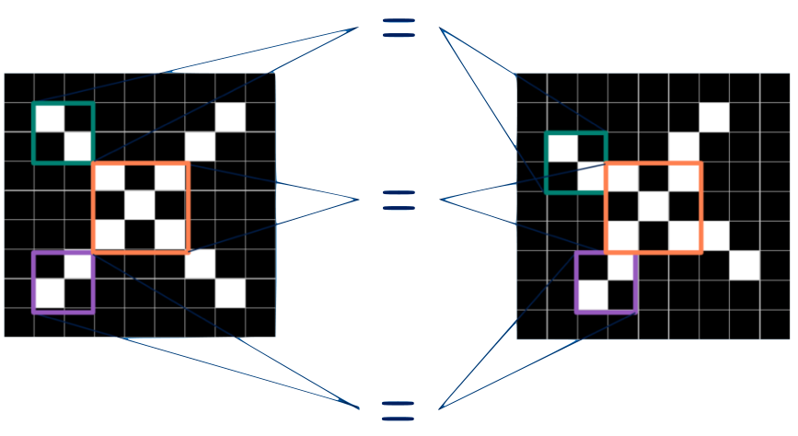
Deep Learning – Convolution Layers
Object detection with convolutions
http://brohrer.github.io/how_convolutional_neural_networks_work.html
http://brohrer.github.io/how_convolutional_neural_networks_work.html

Slide 84
Deep Learning – Convolution Layers
Window 3x3
Output 3x3
Input 5x5
Padding: extra "fake" pixels at the edge of the input image to obtain output with same dimension as input.

Slide 85

Deep Learning – Convolution Layers
Max Pooling / Subsampling Layer
- used after convolutional layers
- to spatially downsample data and avoid overfitting
- allows subsequent convolution layers to see a greater spatial extent of the inputs
- simplifies the information in the output from the convolutional layer
- reduces the number of parameters
Condensed feature map
By Aphex34 - Own work, CC BY-SA 4.0, https://commons.wikimedia.org/w/index.php?curid=45673581

Slide 86
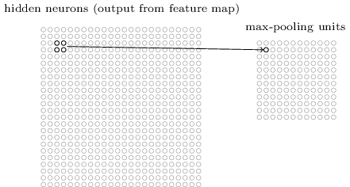
Deep Learning – Convolution Layers
Max Pooling / Subsampling Layer
Each unit in the pooling layer summarizes a region of i.e. 2x2 neurons in the previous layer.
In max-pooling a pooling unit outputs the maximum activation in the 2x2 input region.
Neural Networks and Deep learning by Michael Nielsen.

Slide 87
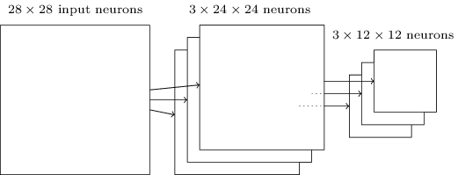
Deep Learning – Convolution Layers
Max Pooling / Subsampling Layer
Max-pooling ‘asks’ weather a feature is found anywhere in a region of the image.
Then throws away the exact positional information.
The location relative to other features is important.
Neural Networks and Deep learning by Michael Nielsen.

Slide 88
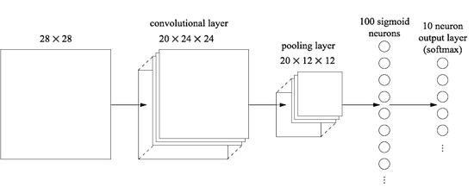
Deep Learning – Convolution Layers
Dense layer
Neural Networks and Deep learning by Michael Nielsen.

Slide 89
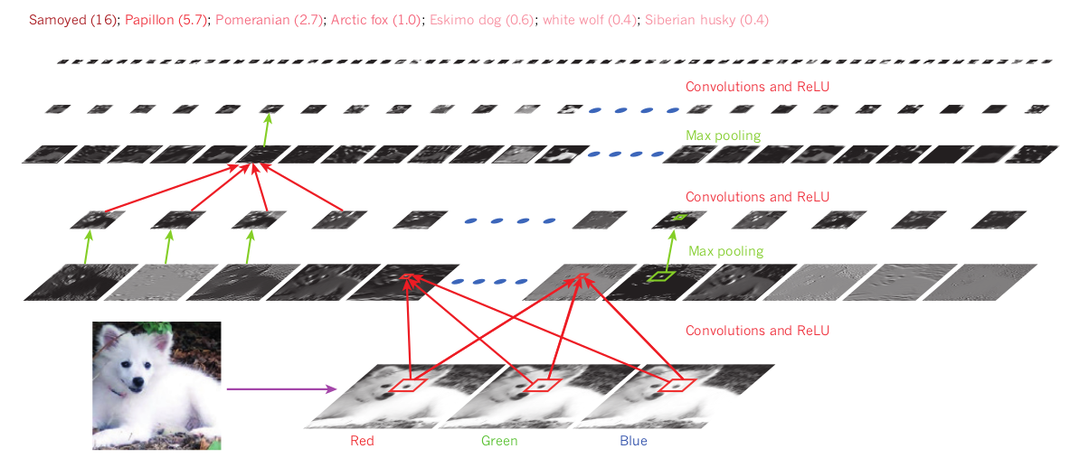
Deep Learning – Convolution Layers
LeCun Y et al, 4 3 6 | NAT U R E | VO L 5 2 1 | 2 8 M AY 2 0 1 5

Slide 90
Deep Learning – Pretrained Convnets
- used with small datasets
- it is a saved network previously trained on a large dataset
- the convolutional base is frozen before compiling and training the model (frozen = preventing the weights from being updated during training)
- feature extraction: take the convolutional base of a pretrained network, run new data and train a new classifier on top of the output.
- fine-tuning: unfreezing few of the top layers of a frozen model base used for feature extraction and train together the new part of the layer and the top layers
Adapted from ‘Deep Learning with Python’ by Francois Chollet.

Slide 91

VGG Net (Visual Geometry Group)
- 19 layer CNN : 3x3 filters with stride and pad of 1, along with 2x2
maxpooling layers with stride 2.
- worked well on both image classification and localization.
- used ReLU layers after each conv layer and trained with batch
gradient descent.
https://gist.github.com/baraldilorenzo/07d7802847aaad0a35d3

Slide 92
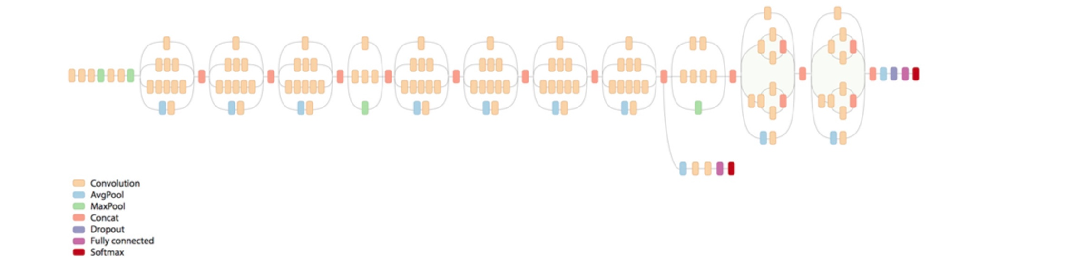
GoogLeNet (2015)
- 22 layer CNN
- at each layer of CNN you have to make a choice of pooling or a conv operation (there is also the choice of filter size).
- an Inception module allows you to do is perform all of these operations in parallel
- no fully connected layers: uses an average pool instead

Slide 93
05_Introduction_to_Convnets notebook
06_Train_Convnets notebook
07_Pretrained_Convnets notebook
08_How_Convnets_Learn notebook

Slide 94
Deep Learning – Recurrent Neural Networks
RNN
- processes sequence of inputs one timestep at a time and maintains a state throughout
- state: a vector or set of vectors, a point in a geometric space of states
- process sequences by iterating through the sequence elements and maintaining a state containing information about what it has seen so far
- it has an internal loop
- the state of the RNN is reset between processing 2 different sequences and the data point is not processed in a single step but the network loops over it
Adapted from ‘Deep Learning with Python’ by Francois Chollet.

Slide 95

Deep Learning – Recurrent Neural Networks (RNN)
Recurrent connection
Input
RNN
Output
- used in case of sequences where recent past is more important than distant past
- like a very deep feedforward network in which all layers have the same weights
- output h_{t} at time t depends on not just x_{t} and also x’s previous time steps
- process input sequences one element at a time, maintaining in the hidden units a ‘state vector’ that contains information about the history of past elements of the sequence
- but it does not store information for very long
LeCun Y et al, 4 3 6 | NAT U R E | VO L 5 2 1 | 2 8 M AY 2 0 1 5
https://colah.github.io/posts/2015-08-Understanding-LSTMs/

Slide 96

Deep Learning – Recurrent Neural Networks (RNN)
- used in text and speech analysis
- timeseries regression, timeseries classification, anomaly detection in timeseries
output
input
label one image with a sentence
sequence of images (video) and produce a sentence for it
translations
https://wiki.tum.de/display/lfdv/Recurrent+Neural+Networks+-+Combination+of+RNN+and+CNN

Slide 97
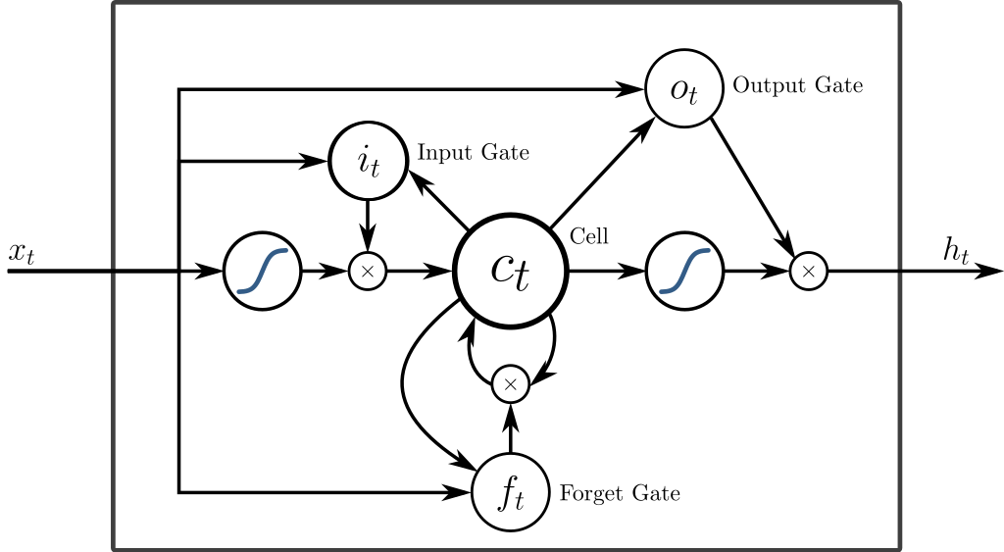
Deep Learning – Long Short-Term Memory
- LSTM is a special kind of RNN.
- It saves information for later preventing older signals from gradually vanishing during processing.
- It contains information outside the normal flow of the recurrent network in a gated cell.
- Memory cells that acts like an accumulator
- This information can be stored in, written to, or read from a cell that makes decisions about what to store, and when to allow reads, writes and erasures, via gates that open and close.
By https://commons.wikimedia.org/wiki/User:BiObserve (Raster version previously uploaded to Wikimedia)Alex Graves, Abdel-rahman Mohamed, and Geoffrey Hinton (original)Eddie Antonio Santos (SVG version with TeX math) - https://commons.wikimedia.org/wiki/File:Long_Short_Term_Memory.pngAlex Graves, Abdel-rahman Mohamed, and Geoffrey Hinton. Speech recognition with deep recurrent neural networks. In Acoustics, Speech and Signal Processing (ICASSP), 2013 IEEE International Conference on, pages 6645–6649. IEEE, 2013., CC BY-SA 4.0, https://commons.wikimedia.org/w/index.php?curid=59931189

Slide 98
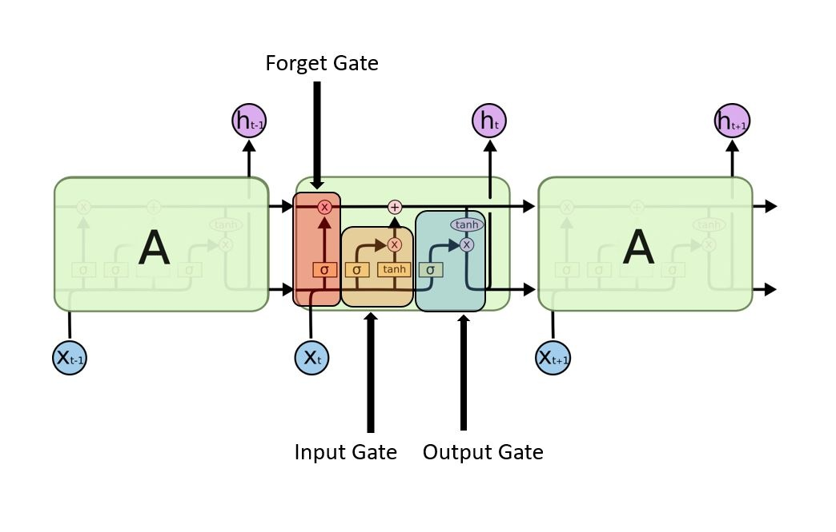
Deep Learning – Long Short-Term Memory
LSTM block
https://wiki.tum.de/display/lfdv/Recurrent+Neural+Networks+-+Combination+of+RNN+and+CNN

Slide 99

Recurrent Neural Networks – Generate Sequence Data
- Neural networks can generate sequence data:
- text generation
- sequence musical notes
- molecule design
- speech synthesis and dialogue generation (chatbots)
- e.g Smart Reply Google: quick replies of emails or text messages.
https://www.blog.google/products/gmail/save-time-with-smart-reply-in-gmail/

Slide 100
Recurrent Neural Networks – Generate Sequence Data
- Generate discrete sequence data by training a model to predict the next token(s) (e.g. words or characters), given previous token.
- Text: language model based on either words or characters.
- Sampling next token requires balance between adhering to what the model judges likely, and introducing randomness.
- Softmax temperature:
- parameter controlling the amount of stochasticity in the sampling process - how surprising or predictable the choice of the next character will be
Adapted from ‘Deep Learning with Python’ by Francois Chollet.

Slide 101
09_Recurrent_Neural_Networks notebook
10_LSTM notebook

Slide 102
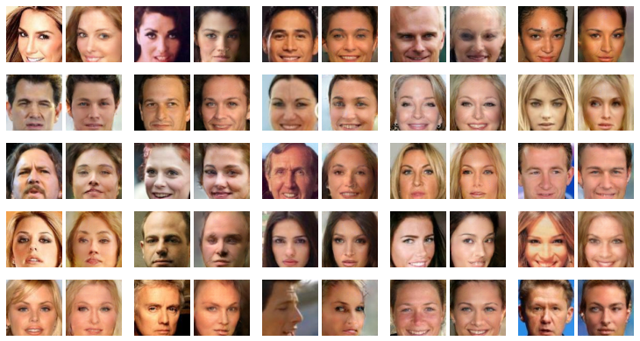
Generative Adversarial Networks
- Consist of a generator network coupled with a discriminator network.
- The discriminator is trained to differentiate the output of of the generator and real images from a training set.
- The generator is trained to fool the discriminator.
- The generator never sees images from the training set directly, the information about the data comes from the discriminator.
- GANs are difficult to train (requires heuristic tricks, optimization minimum is not fixed).
- GANs can potentially produce very realistic images.
https://devblogs.nvidia.com/photo-editing-generative-adversarial-networks-2/

Slide 103
Generative Adversarial Networks
https://devblogs.nvidia.com/photo-editing-generative-adversarial-networks-2/

Slide 104
Deep Autoregressive Generative Sequence Models
- like an RNN the output time t depends on x_{t} and x’s from previous time steps
- the previous x’s are not provided via some hidden state: they are given as another input to the model
- it is a feed-forward model which predicts future values from past values: x₁, x₂,...,x_{k} and predict x_{k+1}
- it is a generative model: it can generate new data after learning from the dataset
- there has been success at applying them to non-sequential data
- it can generate continuous and discrete data (text), It’s hard to generate discrete data for GANs
https://eigenfoo.xyz/deep-autoregressive-models/

Slide 105
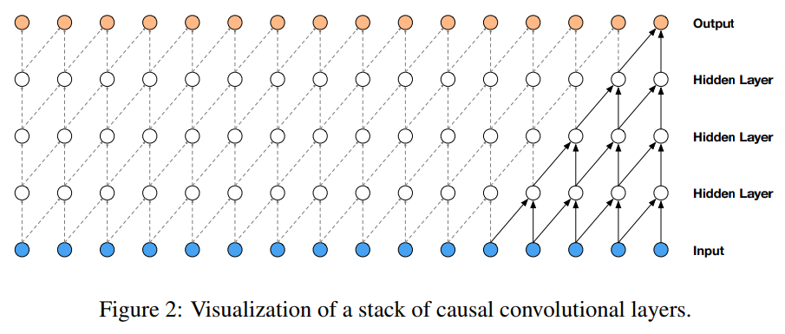
Deep Autoregressive Generative Sequence Models
WaveNet a Generative Model For Raw Audio
- the model is fully probabilistic and autoregressive, with the predictive distribution for each audio sample conditioned on all previous ones
- applied to text-to-speech, human listeners rating it as significantly more natural sounding
https://arxiv.org/pdf/1609.03499.pdf

Slide 106
Hardware
- Deep learning models require more computational power than what a laptop can deliver.
- Development of massive parallel chips (graphical processing units or GPUs).
- Small numbers of GPUs replaced clusters of CPU.
- Deep neural networks are highly parallelizable.
- GPUs speed up training.
- Running Jupyter notebooks on AWS allows the use of one or several GPUs (you pay for what you use).

Slide 107
Deep Learning – Limitations
- Problems involving reasoning, long-term planning and algorithmic data manipulation are not solved by deep learning.
- Cannot generate models or discover causal mechanisms from data.
- Requires a large amount of data to be trained and they need training every time they are presented with (even slightly) different data.
- Very sensitive to changes in an image which would not fool a human observer.

Slide 108
Deep Learning – References
1- Deep learning. Yann LeCun, Yoshua Bengio, Geoffrey Hinton. Nature volume 521, pages 436–444 (28 May 2015).
2- ImageNet Classification with Deep Convolutional Neural Networks. Alex Krizhevsky, Ilya Sutskever, Geoffrey E. Hinton. Advances in Neural Information Processing Systems 25 (NIPS 2012).
3- Convolutional networks for images, speech, and time series. Yann LeCun, Yoshua Bengio. The handbook of brain theory and neural networks. M.A. Arbib, PublisherMIT Press. 1995.
4- Very Deep Convolutional Networks for Large-Scale Image Recognition. Karen Simonyan, Andrew Zisserman. arXiv:1409.155. 2015.
5- Flexible, High Performance Convolutional Neural Networks for Image Classification. Dan Claudiu Ciresan, Ueli Meier, Jonathan Masci, Luca Maria Gambardella, Jürgen Schmidhuber. Proceedings of the Twenty-Second International Joint Conference on Artificial Intelligence. 2011.
6- Grad-CAM: Visual Explanations from Deep Networks via Gradient-based Localization. Ramprasaath R. Selvaraju, Michael Cogswell, Abhishek Das, Ramakrishna Vedantam, Devi Parikh, Dhruv Batra. ArXiv:1610.02391. 2017.
7- A Neural Probabilistic Language Model. Yoshua Bengio, Réjean Ducharme, Pascal Vincent, Christian Jauvin. Journal of Machine Learning Research 3 (2003) 1137–1155.
8- Empirical Evaluation of Gated Recurrent Neural Networks on Sequence Modeling. Junyoung Chung, Caglar Gulcehre, KyungHyun Cho, Yoshua Bengio. ArXiv:1412.3555. 2014.

